Slide 1

Czech republic
Prague

Slide 2
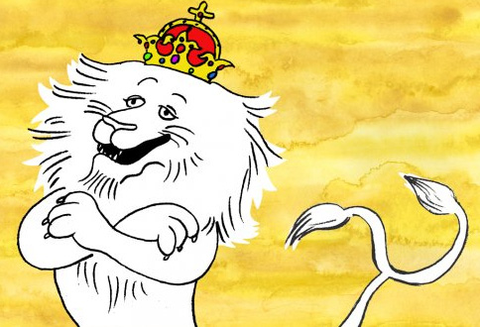
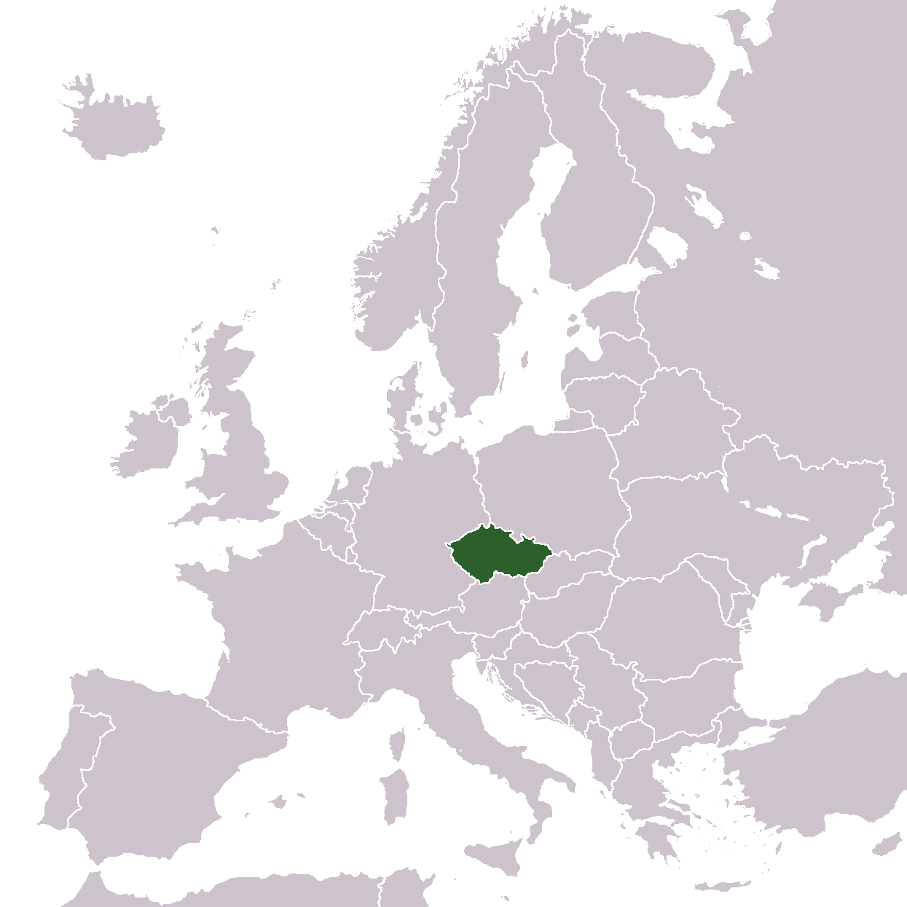
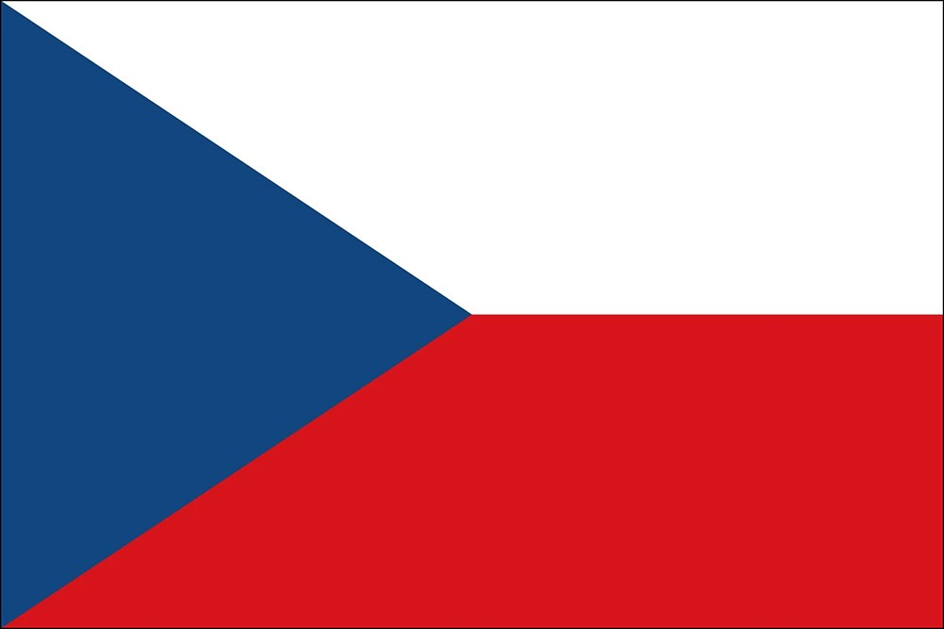
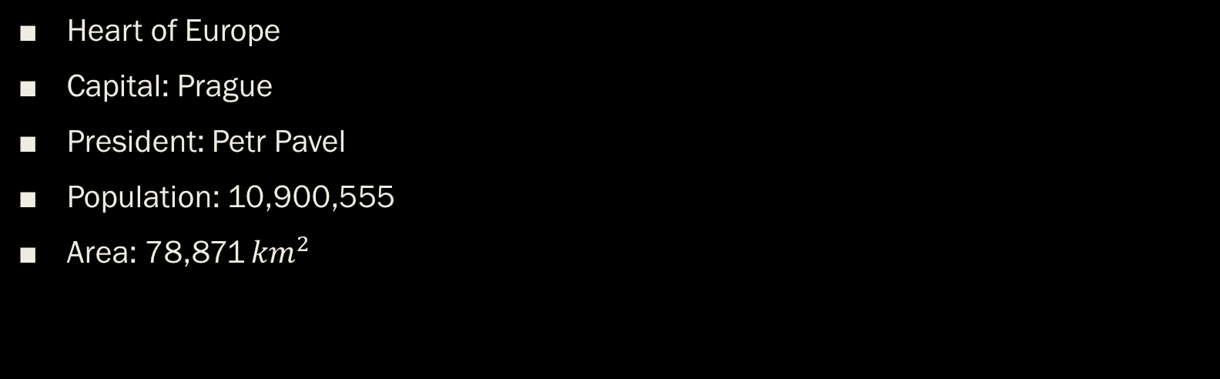
Czech Republic
Heart of Europe
Capital: Prague
President: Petr Pavel
Population: 10,900,555
Area: 78,871 ${km}^{2}$

Slide 3
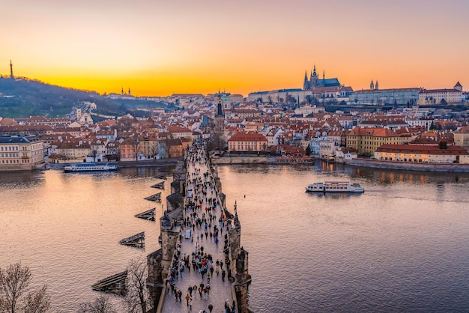
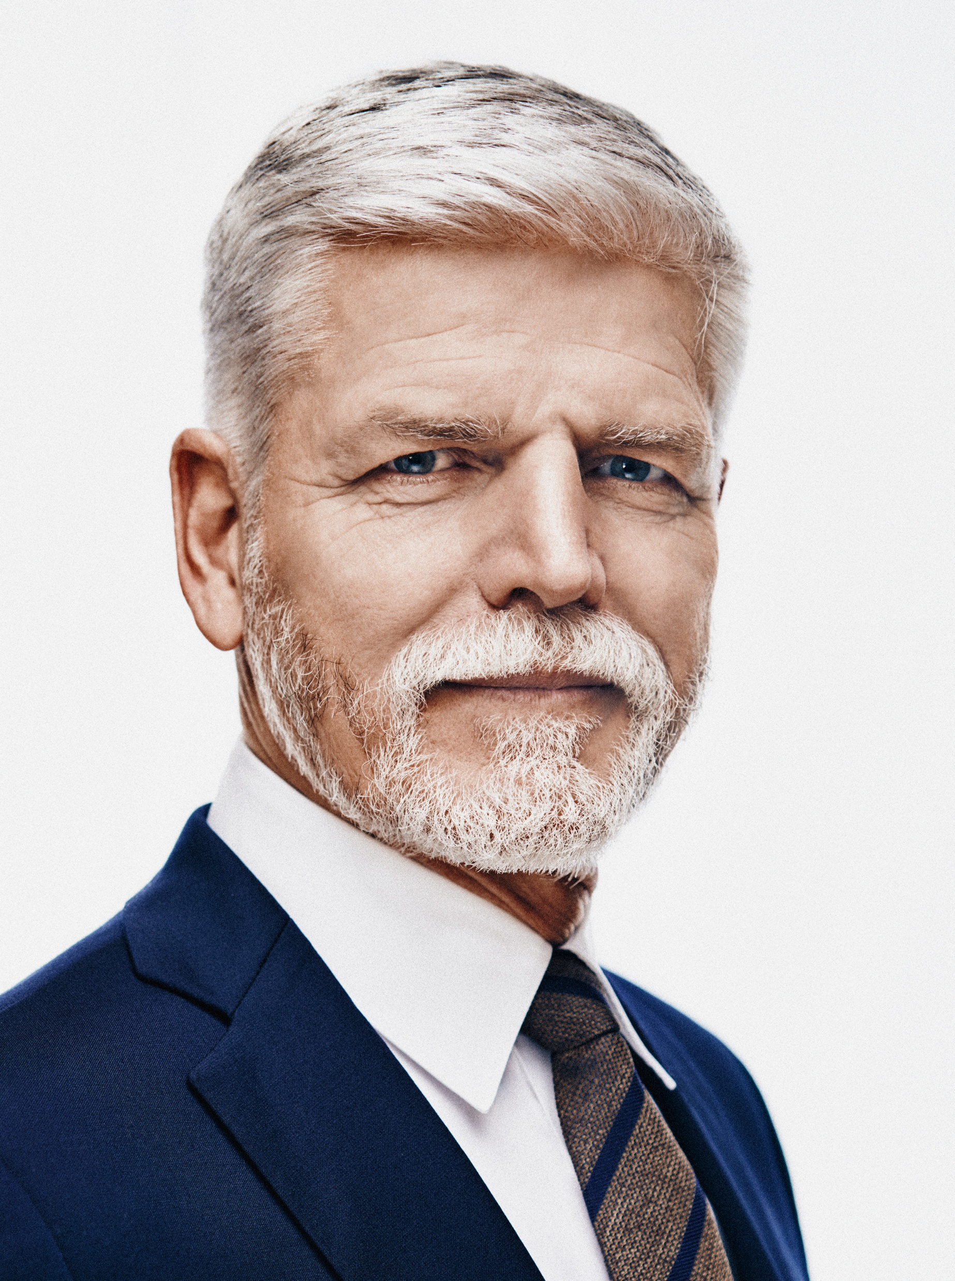
Prague
Capital city
The president‘s residence
Prague castle
Vltava river
Charles bridge
Wenceslas square

Slide 4
THANK YOU FOR YOUR ATTENtION

